Slide 1
UNIT II
UNIT – II VIRTUALIZATION AND COMMON STANDARDS IN CLOUD COMPUTING
Implementation Levels of Virtualization, Virtualization Structures/Tools and Mechanisms, Types of Hypervisors, Virtualization of CPU, Memory, and I/O Devices, Virtual Clusters and Resource Management, Virtualization for Data-Center Automation.
Common Standards: The Open Cloud Consortium, Open Virtualization Format, Standards for Application Developers: Browsers (Ajax), Data (XML, JSON), Solution Stacks (LAMP and LAPP),Syndication (Atom, Atom Publishing Protocol, and RSS), Standards for Security.

Slide 2
VIRTUALIZATION AND COMMON STANDARDS IN CLOUD COMPUTING
The reincarnation of virtual machines (VMs) presents a great opportunity for parallel, cluster, grid, cloud, and distributed computing.
Virtualization technology benefits the computer and IT industries by enabling users to share expensive hardware resources by multiplexing VMs on the same set of hardware hosts.
This unit covers virtualization levels, VM architectures, virtual networking, virtual cluster construction.

Slide 3
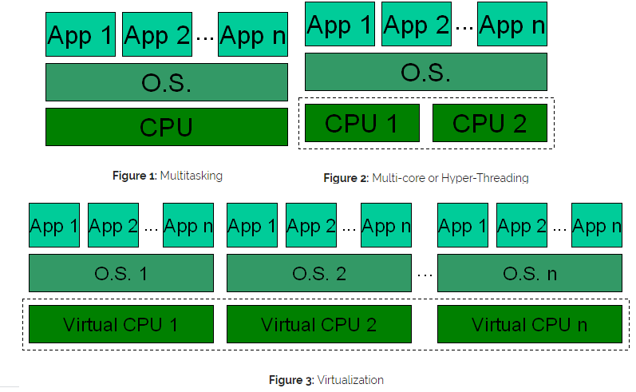
Multi-core Vs. Virtualization Architecture

Slide 4
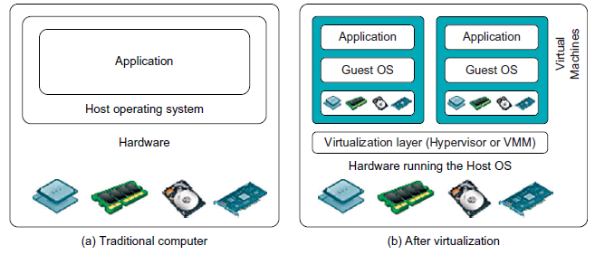
Implementation Levels of Virtualization
Virtualization is a computer architecture technology by which multiple virtual machines (VMs) are multiplexed in the same hardware machine.
Hardware resources (CPU, memory, I/O devices, etc.) or software resources (operating system and software libraries) can be virtualized in various functional layers.
A traditional computer runs with a host operating system specially tailored for its hardware architecture, as shown in Figure (a).

Slide 5
Levels of Virtualization Implementation
After virtualization, different user applications managed by their own operating systems (guest OS) can run on the same hardware, independent of the host OS.
This is often done by adding additional software, called a virtualization layer as shown in Figure (b).
This virtualization layer is known as hypervisor or virtual machine monitor (VMM) .
The VMs are shown in the upper boxes, where applications run with their own guest OS over the virtualized CPU, memory, and I/O resources.
The main function of the software layer for virtualization is to virtualize the physical hardware of a host machine into virtual resources to be used by the VMs, exclusively.
This can be implemented at various operational levels.

Slide 6
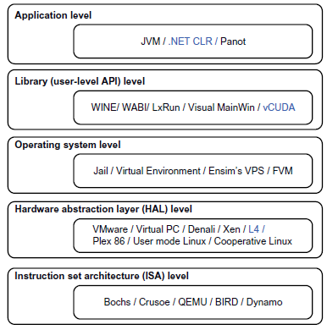
Levels of Virtualization Implementation
The virtualization software creates the abstraction of VMs by interposing a virtualization layer at various levels of a computer system.
Common virtualization layers include the instruction set architecture (ISA) level, hardware level, operating system level, library support level, and application level (see Figure).
At the ISA level, virtualization is performed by emulating a given ISA by the ISA of the host machine.
Instruction set emulation requires binary translation and optimization. A virtual instruction set architecture (V-ISA) thus requires adding a processor-specific software translation layer to the compiler.
Virtualization ranging from hardware to applications in five abstraction levels.

Slide 7
Levels of Virtualization Implementation
Hardware-level virtualization is performed right on top of the bare hardware.
The idea is to virtualize a computer’s resources, such as its processors, memory, and I/O devices.
Recently, the Xen hypervisor has been applied to virtualize x86-based machines to run Linux or other guest OS applications.
Operating System Level Virtualization refers to an abstraction layer between traditional OS and user applications.
OS-level virtualization creates isolated containers on a single physical server and the OS instances to utilize the hardware and software in data centers. The containers behave like real servers.
OS-level virtualization is commonly used in creating virtual hosting environments to allocate hardware resources among a large number of mutually distrusting users.
It is also used, to a lesser extent, in consolidating server hardware by moving services on separate hosts into containers or VMs on one server.

Slide 8
Levels of Virtualization Implementation
Library Support Level
Most applications use APIs exported by user-level libraries rather than using lengthy system calls by the OS. Since most systems provide well-documented APIs, such an interface becomes another candidate for virtualization.
Virtualization with library interfaces is possible by controlling the communication link between applications and the rest of a system through API hooks.
The software tool WINE has implemented this approach to support Windows applications on top of UNIX hosts.
Another example is the vCUDA which allows applications executing within VMs to leverage GPU hardware acceleration.

Slide 9
Levels of Virtualization Implementation
User-Application Level
Virtualization at the application level virtualizes an application as a VM. On a traditional OS, an application often runs as a process.
Therefore, application-level virtualization is also known as process-level virtualization.
The most popular approach is to deploy high level language (HLL) VMs.
In this scenario, the virtualization layer sits as an application program on top of the operating system, and the layer exports an abstraction of a VM that can run programs written and compiled to a particular abstract machine definition.
Any program written in the HLL and compiled for this VM will be able to run on it. The Microsoft .NET CLR (Common Language Runtime) and Java Virtual Machine (JVM) are two good examples of this class of VM. Other forms of application-level virtualization:
application isolation, application
sandboxing, or application streaming.
“Application Isolation” refers to the effort required to isolate resources committed to different VMs.

Slide 10
VMM Design Requirements and Providers
Hardware-level virtualization inserts a layer between real hardware and traditional operating systems. This layer is commonly called the Virtual Machine Monitor (VMM) and it manages the hardware resources of a computing system.
Each time programs access the hardware the VMM captures the process like traditional OS.
One hardware component, such as the CPU, can be virtualized as several virtual copies.
Therefore, several traditional operating systems which are the same or different can sit on the same set of hardware simultaneously.

Slide 11
VMM Design Requirements and Providers
There are 3 requirements for a VMM.
1. VMM should provide an environment for programs which is essentially identical to the original machine.
2. Programs run in this environment should show only minor decreases in speed.
3. A VMM should be in complete control of the system resources.
Any program run under VMM should exhibit a function identical to that which it runs on the original machine directly.
Two possible exceptions are permitted with this requirement:
differences caused by the availability of system resources
arises when more than one VM is running on the same machine.
differences caused by timing dependencies.
because of the effect of any other VMs concurrently existing on same hardware.

Slide 12
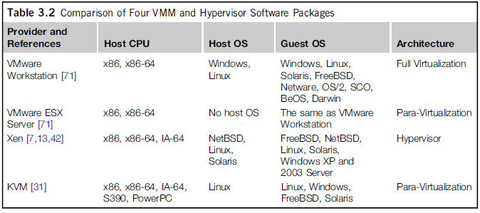
VMM Design Requirements and Providers
For Efficiency of a VMM, a subset of the virtual processor’s instructions needs to be executed directly by the real processor, with no software intervention by the VMM.
Four hypervisors and VMMs that are in use today.
VMM includes the following aspects:
(1) The VMM is responsible for allocating hardware resources for programs;
(2) A program can not access any resource not explicitly allocated to it; and
(3) it is possible for a VMM to regain control of resources already allocated.

Slide 13
Hardware Virtualization
The term hardware virtualization is used when VMM or virtual machine software or any hypervisor gets directly installed on the hardware system. Also termed as Server Virtualization when done for server platform.
It involves embedding virtual machine software into the server's hardware components. That software is called the hypervisor.
The hypervisor manages the shared physical hardware resources between the guest OS & the host OS.
Hardware virtualization is achieved by abstracting the physical hardware part using Virtual Machine Monitor (VMM) or hypervisor.
Hypervisors rely on command set extensions in the processors to accelerate common virtualization activities for boosting the performance.
The primary task of the hypervisor is to process monitoring, memory & hardware controlling. Different operating systems can be installed, and various applications can run on it.

Slide 14
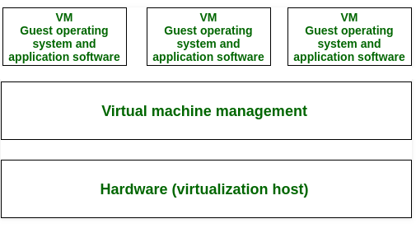
Hardware Virtualization
An abstract execution environment in terms of computer hardware in which guest OS can be run, referred as Hardware-level virtualization.
An operating system represents the guest, the physical computer hardware represents a host, its emulation represents virtual machine, and hypervisor represents the Virtual Machine Manager.
When VMs are allowed to interact with hardware without any intermediary action requirement from the host operating system generally makes hardware-based virtualization more efficient.

Slide 15
Hardware Assisted Virtualization
Virtualization abstracts hardware that allows multiple workloads to share a common set of resources. On shared virtualized hardware, a variety of workloads can co-locate while maintaining full isolation from each other, freely migrate across infrastructures, and scale as needed.
CPU Virtualization is a hardware feature found in all current AMD & Intel CPUs that allows a single processor to act as if it was multiple individual CPUs.
This allows an operating system to more effectively & efficiently utilize the CPU power in the computer so that it runs faster. This feature is also a requirement for many virtual machine software and is required to be enabled in order for them to run properly or even at all.
For Intel CPUs, this feature is called Intel Virtualization Technology, or Intel VT, and with AMD CPUs it is called AMD-V.
Intel VT (Virtualization Technology) is the company's hardware assistance for processors running virtualization platforms.

Slide 16
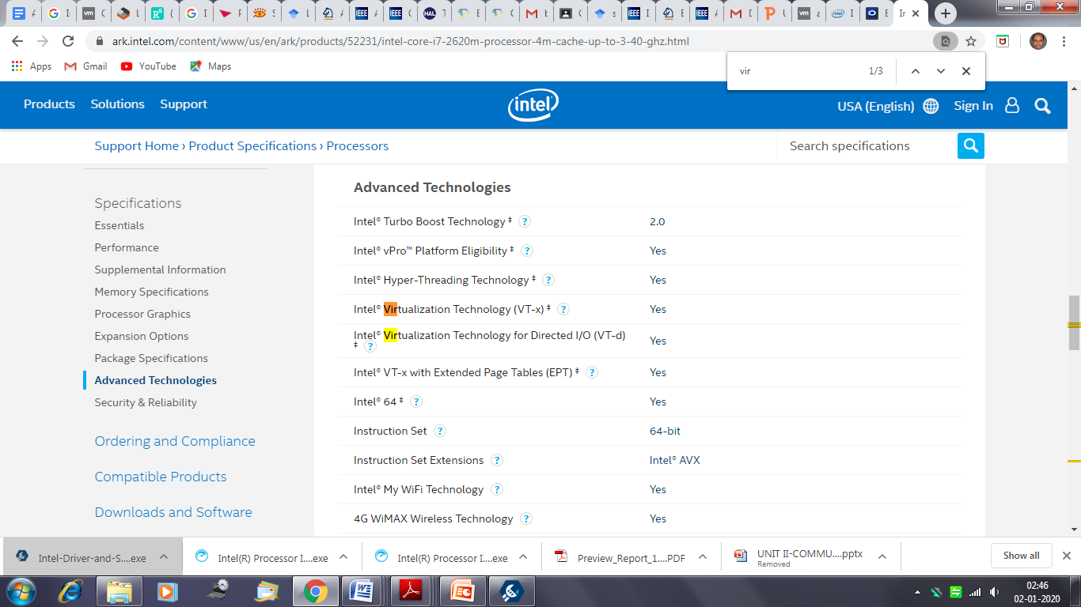
Hardware Assisted Virtualization: Intel Virtualization Technology

Slide 17
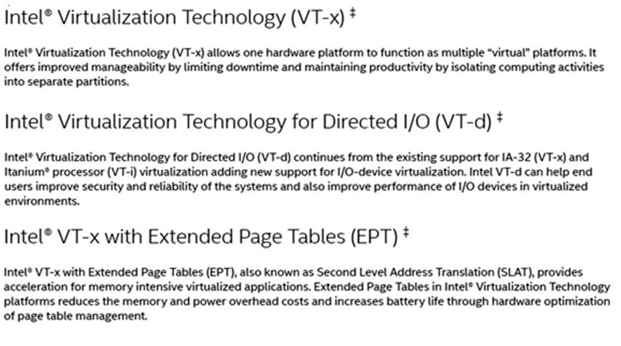
Hardware Assisted Virtualization: Intel Virtualization Technology

Slide 18
Hardware Assisted Virtualization: Intel Virtualization Technology
If there is software such as VMware that enables virtualization, why implement Virtualization Technology inside the CPU?
The advantage is that CPUs with Virtualization Technology have some new instructions to control virtualization.
With them, controlling software (called VMM, Virtual Machine Monitor) can be simpler, thus improving performance compared to software-based solutions.
When the CPU has support to Virtualization Technology, the virtualization is said to be hardware-based or hardware-assisted.
Processors with Virtualization Technology have an extra instruction set called Virtual Machine Extensions or VMX.
VMX brings 10 new virtualization-specific instructions to the CPU: VMPTRLD, VMPTRST, VMCLEAR, VMREAD, VMWRITE, VMCALL, VMLAUNCH, VMRESUME, VMXOFF, and VMXON.

Slide 19
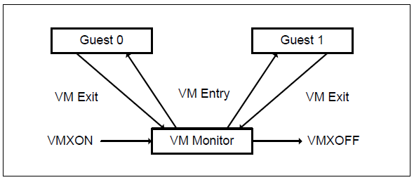
Intel VT: LIFE CYCLE OF VMM SOFTWARE
Software enters VMX operation by executing a VMXON instruction.
Using VM entries, a VMM can then enter guests into virtual machines (one at a time).
The VMM effects a VM entry using instructions VMLAUNCH and VMRESUME; it regains control using VM exits.
VM exits transfer control to an entry point specified by the VMM. The VMM can take action appropriate to the cause of the VM exit and can then return to the virtual machine using a VM entry.
Eventually, the VMM may decide to shut itself down and leave VMX operation. It does so by executing the VMXOFF instruction.

Slide 20
Types of Hardware Virtualization
Hardware virtualization is of three kinds:
Full Virtualization: The complete simulation of the actual hardware takes place to allow the software to run an unmodified guest OS.
Emulation Virtualization: The virtual machine simulates the hardware & is independent. Furthermore, the guest OS doesn't require any modification.
Para-Virtualization: The hardware is not simulated; instead the guest software runs its isolated system.
In this type of virtualization, software unmodified runs in modified OS as a separate system.
Partial Virtualization: In this type of hardware virtualization, the software may need modification to run.

Slide 21
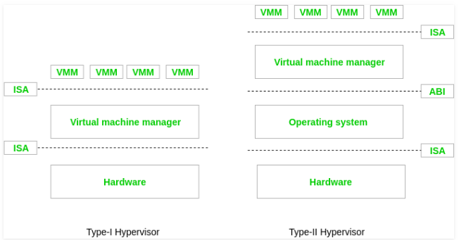
Types of Hypervisor
Type-I hypervisors: It runs at the top of hardware. That’s why they take the place of operating system. They interact directly with the ISA interface exposed by the underlying hardware.
Type-II hypervisor: To provide virtualization services, the support of an operating system is required. The programs managed by the OS, which interact with Type II hypervisor through the ABI and emulate the ISA of virtual hardware for guest operating system.

Slide 22
Types of Hypervisor
Advantages of hardware-based virtualization – It reduces the maintenance overhead of para-virtualization as it reduces (ideally, eliminates) the modification in the guest operating system.
Disadvantages of hardware-based virtualization –
Hardware-based virtualization requires explicit support in the host CPU, which may not available on all x86/x86_64 processors.
A “pure” hardware-based virtualization approach, including entire unmodified guest operating system, involves many VM traps, and thus rapid increase in CPU overhead occurs which limits the scalability and efficiency of server consolidation.
This performance hit can be mitigated by the use of para-virtualized drivers; the combination has been called “hybrid virtualization”.

Slide 23
Operating system-based virtualization
It is the installation of virtualization software in a pre-existing operating system, which is called the host operating system (Figure 1). For example, a user whose workstation has a specific version of Windows installed decides it wants to generate virtual machines.
It installs the virtualization software into its host operating system like any other program and uses this application to generate and operate one or more virtual machine.
Since the host operating system can provide hardware devices with the necessary support, operating system virtualization can rectify hardware compatibility issues even if the hardware driver is unavailable to the virtualization software.
Hardware independence that is enabled by virtualization allows hardware IT resources to be more flexibly used. For example, let’s take a scenario in which the host operating system has the software necessary for controlling five network adapters that are available to the physical computer. The virtualization software can make the five network adapters available to the virtual machine.

Slide 24
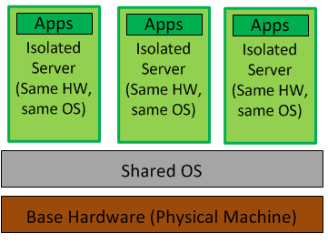
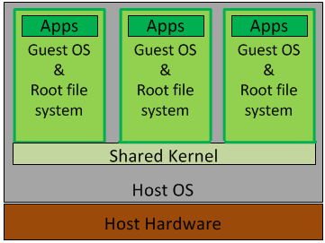
Operating system-based virtualization
Operating system level virtualization is achieved by the host system running a single OS kernel and through its control of guest operating system functionality.
It is a technique where the kernel of an operating system allows for multiple isolated user-space instances. These instances run on top of an existing host operating system and provide a set of libraries that applications interact with, giving them the illusion that they are running on a machine dedicated to its use. The instances are known as Containers, Virtual Private Servers or Virtual Environments.
Under this shared kernel virtualization the virtual guest systems each have their own root file system but share the kernel of the host operating system.

Slide 25
Operating system-based virtualization
This is a special case of Hosted Virtualization where the hypervisor (the container) has very limited functionality, relying on the Host OS for CPU scheduling and memory management.
This method uses virtualization at the OS level, doesn’t even include the use of a real hypervisor; instead, the virtualization capabilities are part of the hosting operating system, which performs all the functions of the hypervisor. Examples: OpenVZ, Virtuozzo, Solaris Zones. SmartOS, Citrix and XenServer.
Advantages of OS Level Virtualization
This form of virtualization usually imposes little or no overhead thereby ensuring most of the machine’s resources are available to the applications running in the containers.
This is a cost-effective and efficient solution for creating similar guests, but it’s only practical for certain situations. It is an ideal approach for web hosting companies which have multiple virtual web servers running on a single box or blade.
This is very convenient because patches or modifications can be made to the host server and they will instantly be applied to all of the containers.

Slide 26
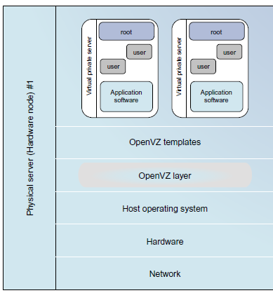
Operating system-based virtualization
Limitations of OS Level Virtualization
This approach typically limits operating system choice.
Containerization usually means that every guest OS must be identical or similar to the host in terms of version number and patch level.
For example, with Linux as the host operating system, only Linux distributions can be run as the guest operating systems. This can cause problems if you want to run different applications in the containers, since applications are often certified for only a certain OS version and patch level.
It is not possible for a Linux guest system designed for the 3.0.9 version of the kernel to share a 3.1.1 version kernel.

Slide 27
Virtualization Support at the OS Level
Operating system virtualization inserts a virtualization layer inside an operating system to partition a machine’s physical resources.
It enables multiple isolated VMs within a single operating system kernel. This kind of VM is often called a virtual execution environment (VE), Virtual Private System (VPS), or simply container.
Although VEs can be customized for different people, they share the same operating system kernel. Therefore, OS-level virtualization is also called single-OS image virtualization.

Slide 28
Virtualization Support at the OS Level
Why OS-Level Virtualization?
It is slow to initialize a hardware-level VM as hardware-level VMs are fully isolated and each of them runs a separate operating system kernel. Initializing such a VM incurs large overhead in terms of both resource requirement and startup delays.
A VM can share the execution environment of the host machine, but any state changes in the VM are limited in the VM’s local environment. Therefore, such a VM has minimal start-up/shutdown cost, low resource requirement, and high scalability.
Storing the VM images also becomes an issue.
Full virtualization at the hardware level also has the disadvantages of slow performance and low density, and the need for para-virtualization to modify the guest OS.
OS-level virtualization provides a feasible solution for these hardware-level virtualization issues.

Slide 29
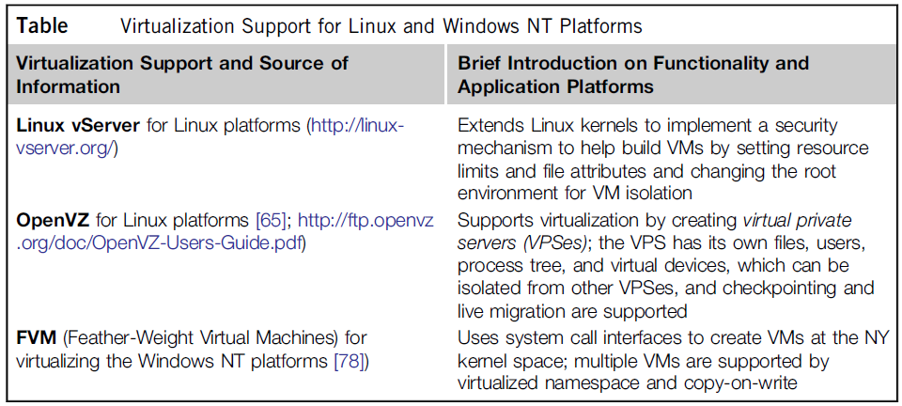
Virtualization on Linux or Windows Platforms
Table summarizes several examples of OS level virtualization tools that have been developed in recent years. Two OS tools (Linux vServer and OpenVZ) support Linux platforms to run other platform-based applications through virtualization.
The third tool, FVM, is an attempt specifically developed for virtualization on the Windows NT platform.

Slide 30
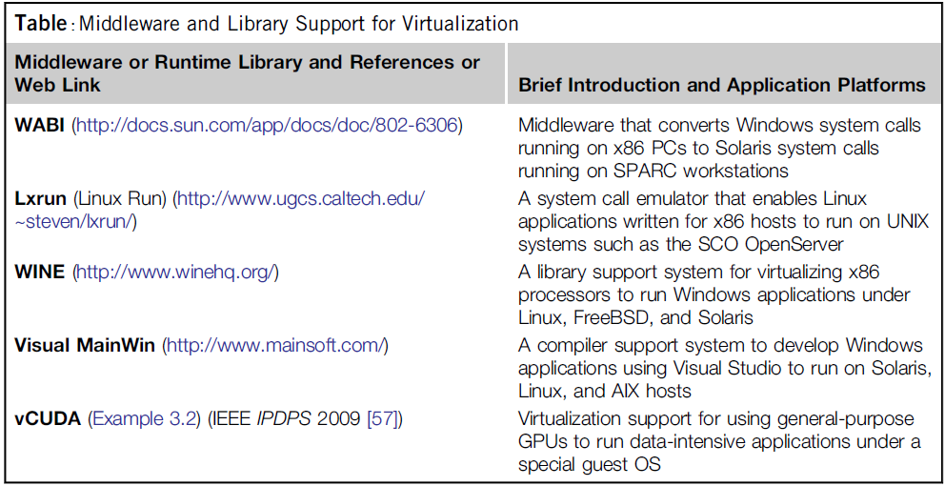
Middleware Support for Virtualization
Library-level virtualization is also known as user-level Application Binary Interface (ABI) or API emulation. This type of virtualization can create execution environments for running alien programs on a platform rather than creating a VM to run the entire operating system.
API call interception and remapping are the key functions performed.

Slide 31
Middleware Support for Virtualization
The vCUDA for Virtualization of General-Purpose GPUs:
CUDA (Compute Unified Device Architecture) is a programming model and library for general-purpose GPUs. It leverages the high performance of GPUs to run compute-intensive applications on host operating systems.
vCUDA virtualizes the CUDA library and can be installed on guest OSes. When CUDA applications run on a guest OS and issue a call to the CUDA API, vCUDA intercepts the call and redirects it to the CUDA API running on the host OS. Figure next shows the basic concept of the vCUDA architecture .
The vCUDA employs a client-server model to implement CUDA virtualization.
It consists of three user space components: the vCUDA library, a virtual GPU in the guest OS (which acts as a client), and the vCUDA stub in the host OS (which acts as a server).
The vCUDA library resides in the guest OS as a substitute for the standard CUDA library. It is responsible for intercepting and redirecting API calls from the client to the stub. Besides these tasks, vCUDA also creates vGPUs and manages them.

Slide 32
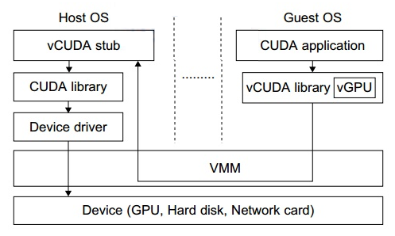
Middleware Support for Virtualization
Basic Concept of vCUDA Architecture:

Slide 33
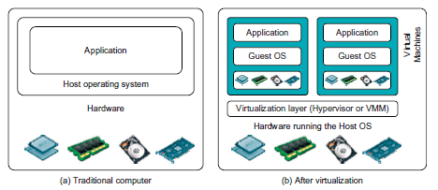
VIRTUALIZATION STRUCTURES/TOOLS AND MECHANISMS
After virtualization, a virtualization layer is inserted between the hardware and the operating system. In such a case, the virtualization layer is responsible for converting portions of the real hardware into virtual hardware. Therefore, different operating systems such as Linux and Windows can run on the same physical machine, simultaneously.
In general, there are three typical classes of VM architecture. Depending on the position of the virtualization layer, there are several classes of VM architectures, namely the hypervisor architecture, para virtualization, and host-based virtualization.

Slide 34
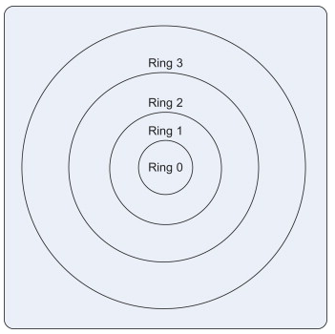
Techniques for Hypervisor
There are different techniques used for hypervisor based virtualization.
Trap and Emulate Virtualization:
At a very high level, the guests continue execution until they try to access a shared physical resource of the hardware (such as an I/O device), or an interrupt is received.
When this happens, the hypervisor regains control and mediates access to the hardware, or handles the interrupt.
To accomplish this functionality, hypervisors rely on a feature of modern processors known as the privilege level or protection ring. (why protected mode?). The basic idea behind privilege levels is that all instructions that modify the physical hardware configuration are permitted at the highest level, at lower levels, only restricted sets of instructions can be executed.

Slide 35
Techniques for Hypervisor
There are four rings, numbered from 0 to 3. Programs executing in Ring 0 have the highest privileges, and are allowed to execute any instructions or access any physical resources such as memory pages or I/O devices.
Guests are typically made to execute in ring 3. This is accomplished by setting the Current Privilege Level (CPL) register of the processor to 3 before starting execution of the guest.
If the guest tries to access a protected resource, such as an I/O device, an interrupt takes place, and the hypervisor regains control.
The hypervisor then emulates the I/O operation for the guest (e.g., Xen or Hyper-V).
In order to emulate the I/O operation, it is necessary for the hypervisor to have maintained the state of the guest and its virtual resources.

Slide 36
Techniques for Hypervisor
Software Extensions to Trap and Emulate Virtualization
Two major software techniques can be used to overcome the limitations of trap and emulate virtualization.
One technique is binary translation. Here the hypervisor includes a binary translator which replaces the sensitive instructions by equivalent non-sensitive instructions at run-time, and leaves non-sensitive instructions unchanged.
It involves examining the executable code of the virtual guest for "unsafe" instructions, translating these into "safe" equivalents, and then executing the translated code.
This technique uses a combination of binary translation for handling privileged and sensitive instructions, and direct execution techniques for user-level instructions.
This technique is very efficient both in terms of performance and in terms of compatibility with the guest OS, which does not need to know that it is virtualized.
However, building binary translation support for such a system is very difficult, and results in significant virtualization overhead.

Slide 37
Techniques for Hypervisor
The other software technique is para-virtualization, where the guest is modified (re-written) not to use the sensitive instruction, but to directly invoke hypervisor APIs which would provide an equivalent service.
Para-virtualization is widely used for reducing the overheads associated with I/O virtualization. In the context of the I/O request, the guest OS would execute a hypervisor API that would perform the I/O.
The disadvantage with this technique is that it is not hypervisor-independent; i.e., the modifications have to be carried out for every hypervisor under which the guest could run.
So, paravirtualization requires rewriting of the guest OS.

Slide 38
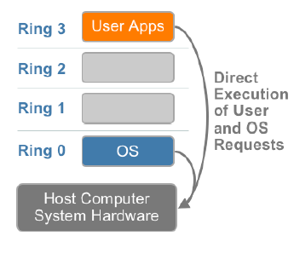
x86 Hardware Virtualization
The x86 architecture offers four levels of privilege known as Ring 0, 1, 2 and 3 to operating systems and applications to manage access to the computer hardware. While user level applications typically run in Ring 3, the operating system needs to have direct access to the memory and hardware and must execute its privileged instructions in Ring 0.

Slide 39
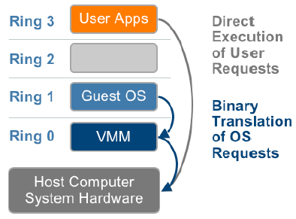
Technique 1: Full Virtualization using Binary Translation
This approach relies on binary translation to trap (into the VMM) and to virtualize certain sensitive and non-virtualizable instructions with new sequences of instructions that have the intended effect on the virtual hardware. Meanwhile, user level code is directly executed on the processor for high performance virtualization.

Slide 40
Technique 1: Full Virtualization using Binary Translation
This combination of binary translation and direct execution provides Full Virtualization as the guest OS is completely decoupled from the underlying hardware by the virtualization layer. The guest OS is not aware it is being virtualized and requires no modification.
The hypervisor translates all operating system instructions at run-time on the fly and caches the results for future use, while user level instructions run unmodified at native speed.
VMware’s virtualization products such as VMWare ESXi and Microsoft Virtual Server are examples of full virtualization.
The performance of full virtualization may not be ideal because it involves binary translation at run-time which is time consuming and can incur a large performance overhead.
The full virtualization of I/O – intensive applications can be a challenge.
Binary translation employs a code cache to store translated hot instructions to improve performance, but it increases the cost of memory usage.

Slide 41
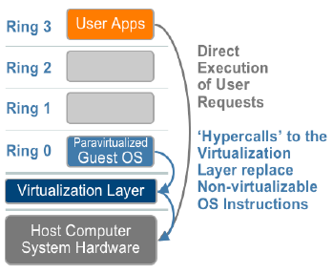
Technique 2: OS Assisted Virtualization or Paravirtualization (PV)
Paravirtualization refers to communication between the guest OS and the hypervisor to improve performance and efficiency.
Paravirtualization involves modifying the OS kernel to replace nonvirtualizable instructions with hypercalls that communicate directly with the virtualization layer hypervisor.
The hypervisor also provides hypercall
interfaces for other critical kernel
operations such as memory
management, interrupt
handling and time keeping.

Slide 42
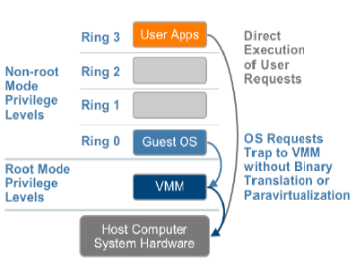
Technique 3: Hardware Assisted Virtualization (HVM)
Intel’s Virtualization Technology (VT-x) (e.g. Intel Xeon) and AMD’s AMD-V both target privileged instructions with a new CPU execution mode feature that allows the VMM to run in a new root mode below ring 0, also referred to as Ring 0P (for privileged root mode) while the Guest OS runs in Ring 0D (for de-privileged non-root mode).
Privileged and sensitive calls are
set to automatically trap to the
hypervisor and handled by
hardware, removing the need
for either binary translation or
para-virtualization.
Vmware only takes advantage
of these first generation
hardware features in limited
cases such as for 64-bit guest
support on Intel processors.

Slide 43
Hypervisor and Xen Architecture
The hypervisor supports hardware-level virtualization (Figure (b)) on bare metal devices like CPU, memory, disk and network interfaces.
The hypervisor provides hypercalls for the guest OSes and applications. Depending on the functionality, a hypervisor can assume a micro-kernel architecture like the Microsoft Hyper-V or it can assume a monolithic hypervisor architecture like the VMware ESX for server virtualization.
A micro-kernel hypervisor includes only the basic and unchanging functions (such as physical memory management and processor scheduling).
The device drivers and other changeable components are outside the hypervisor.
A monolithic hypervisor implements all the aforementioned functions, including those of the device drivers. Therefore, the size of the hypervisor code of a micro-kernel hypervisor is smaller than that of a monolithic hypervisor. A hypervisor must be able to convert physical devices into virtual resources dedicated for the deployed VM to use.

Slide 44
The Xen Architecture
Xen is an open source hypervisor program developed by Cambridge University. Xen is a microkernel hypervisor, which separates the policy from the mechanism.
The Xen hypervisor implements all the mechanisms, leaving the policy to be handled by Domain 0, as shown in Figure .
Xen does not include any device drivers natively. It just provides a mechanism by which a guest OS can have direct access to the physical devices. As a result, the size of the Xen hypervisor is kept rather small.
Xen provides a virtual environment located between the hardware and the OS.
The core components of a Xen system are the hypervisor, kernel, and applications.
Like other virtualization systems, many guest Oses can run on top of the hypervisor. However, not all guest OSes are created equal, and one in particular controls the others.

Slide 45
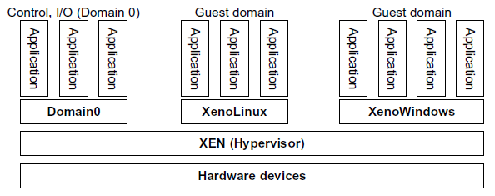
The Xen Architecture
The guest OS, which has control ability, is called Domain 0, and the others are called Domain U. Domain 0 is a privileged guest OS of Xen.
It is first loaded when Xen boots without any file system drivers being available. Domain 0 is designed to access hardware directly and manage devices. Therefore, one of the responsibilities of Domain 0 is to allocate and map hardware resources for the guest domains (the Domain U domains).

Slide 46
Binary Translation with Full Virtualization
Depending on implementation technologies, hardware virtualization can be classified into two categories: full virtualization and host-based virtualization.
Full virtualization does not need to modify the host OS. It relies on binary translation to trap and to virtualize the execution of certain sensitive, non-virtualizable instructions. The guest OSes and their applications consist of noncritical and critical instructions.
With full virtualization, noncritical instructions run on the hardware directly while critical instructions are discovered and replaced with traps into the VMM to be emulated by software.
In a host-based system, both a host OS and a guest OS are used. A virtualization software layer is built between the host OS and guest OS.
Both the hypervisor and VMM approaches are considered full virtualization.

Slide 47
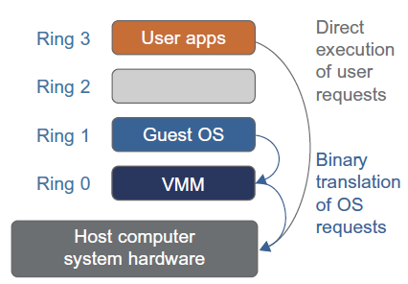
Binary Translation with Full Virtualization
Why are only critical instructions trapped into the VMM?
This is because binary translation can incur a large performance overhead. Noncritical instructions do not control hardware or threaten the security of the system, but critical instructions do. Therefore, running noncritical instructions on hardware not only can promote efficiency, but also can ensure system security.
Binary Translation of Guest OS Requests Using a VMM:
This approach was implemented by VMware and many other software companies. As shown in Figure, VMware puts the VMM at Ring 0 and the guest OS at Ring 1.

Slide 48
Binary Translation with Full Virtualization
Binary Translation of Guest OS Requests Using a VMM:
The VMM scans the instruction stream and identifies the privileged, and sensitive instructions. When these instructions are identified, they are trapped into the VMM, which emulates the behavior of these instructions. The method used in this emulation is called binary translation. Therefore, full virtualization combines binary translation and direct execution. The guest OS is completely decoupled from the underlying hardware. Consequently, the guest OS is unaware that it is being virtualized.
Host-Based Virtualization: An alternative VM architecture is to install a virtualization layer on top of the host OS. This host OS is still responsible for managing the hardware.
The guest OSes are installed and run on top of the virtualization layer. Dedicated applications may run on the VMs. Certainly, some other applications can also run with the host OS directly.

Slide 49
Binary Translation with Full Virtualization
The host based architecture advantages:
1. The user can install this VM architecture without modifying the host OS. The virtualizing software can rely on the host OS to provide device drivers and other low-level services.
This will simplify the VM design and ease its deployment.
2. The host-based approach appeals to many host machine configurations. Compared to the hypervisor architecture, the performance of the host-based architecture may also be low.
When an application requests hardware access, it involves four layers of mapping which downgrades performance significantly.
When the ISA of a guest OS is different from the ISA of the underlying hardware, binary translation must be adopted. Although the host-based architecture has flexibility, the performance is too low to be useful in practice.

Slide 50
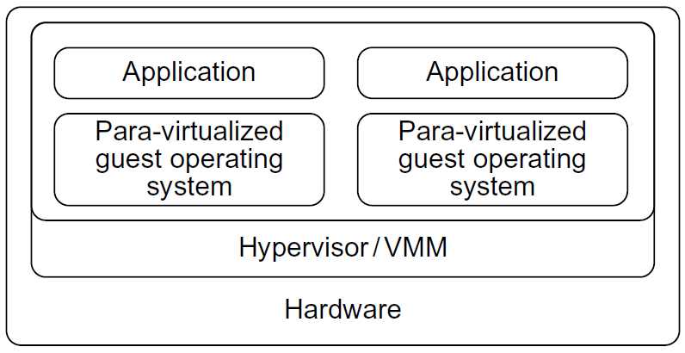
Para-Virtualization with Compiler Support
Para-virtualization needs to modify the guest operating systems. A para-virtualized VM provides special APIs requiring substantial OS modifications in user applications.
The virtualization layer can be inserted at different positions in a machine software stack.
Para-virtualization attempts to reduce the virtualization overhead, and thus improve performance by modifying only the guest OS kernel.
Para-virtualized VM architecture, which involves modifying the guest OS kernel to replace non-virtualizable instructions with hypercalls for the hypervisor or the VMM to carry out the virtualization process.

Slide 51
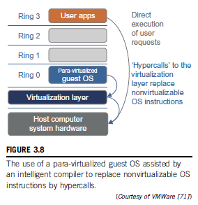
Para-Virtualization with Compiler Support
The guest operating systems are para-virtualized. They are assisted by an intelligent compiler to replace the non-virtualizable OS instructions by hypercalls as illustrated in Figure next.
The traditional x86 processor offers four instruction execution rings: Rings 0, 1, 2, and 3. The lower the ring number, the higher the privilege of instruction being executed. The OS is responsible for managing the hardware and the privileged instructions to execute at Ring 0, while user-level applications run at Ring 3. The best example of para-virtualization is the KVM.

Slide 52
Para-Virtualization with Compiler Support
Privilege Levels
Want operating system to be protected from user processes.
Two bits of code segment selector specify privilege level.
Ring 0 operating system kernel
Ring 1 device drivers
Ring 2 more device drivers
Ring 3 user programs
No one uses ring 1 or ring 2.
Ring 0 can fiddle with:
interrupt handler table
global descriptor table register
Run guest OS in ring 3 (user-level).
Privileged (ring 0 only) operations (e.g., fiddling with page tables) cause interrupts.
Interrupt handler runs VMM code in ring 0. VMM simulates privileged operation, returns to guest OS.

Slide 53
Para-Virtualization with Compiler Support
Para-Virtualization Architecture
When the x86 processor is virtualized, a virtualization layer is inserted between the hardware and the OS. According to the x86 ring definition, the virtualization layer should also be installed at Ring 0.
In Figure, we show that para-virtualization replaces non-virtualizable instructions with hypercalls that communicate directly with the hypervisor or VMM.
When the guest OS kernel is modified for virtualization, it can no longer run on the hardware directly. Problems incurred with para-virtualization:
1. Its compatibility and portability may be in doubt, because it must support the unmodified OS as well.
2. The cost of maintaining para-virtualized OSes is high, because they may require deep OS kernel modifications.
3. The performance advantage of para-virtualization varies greatly due to workload variations.

Slide 54
Full Vs. Para Virtualization
Compared with full virtualization, para-virtualization is relatively easy and more practical.
The main problem in full virtualization is its low performance in binary translation. To speed up binary translation is difficult. Therefore, many virtualization products employ the para-virtualization architecture.
The popular Xen, KVM, and VMware ESX are good examples.
KVM (Kernel-Based VM): This is a Linux para-virtualization system—a part of the Linux version 2.6.20 kernel. Memory management and scheduling activities are carried out by the existing Linux kernel.
The KVM does the rest, which makes it simpler than the hypervisor that controls the entire machine.
KVM is a hardware-assisted para-virtualization tool, which improves performance and supports unmodified guest OSes such as Windows, Linux, Solaris, and other UNIX variants.

Slide 55
Full Vs. Para Virtualization
Unlike the full virtualization architecture which intercepts and emulates privileged and sensitive instructions at runtime, para-virtualization handles these instructions at compile time.
The guest OS kernel is modified to replace the privileged and sensitive instructions with hypercalls to the hypervisor or VMM.
Xen assumes such a para-virtualization architecture.
The guest OS running in a guest domain may run at Ring 1 instead of at Ring 0. This implies that the guest OS may not be able to execute some privileged and sensitive instructions.
The privileged instructions are implemented by hypercalls to the hypervisor. After replacing the instructions with hypercalls, the modified guest OS emulates the behavior of the original guest OS.
On an UNIX system, a system call involves an interrupt or service routine. The hypercalls apply a dedicated service routine in Xen.

Slide 56
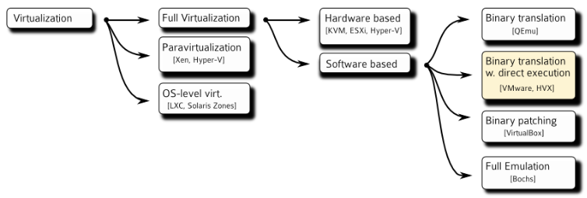
Overview of the different technologies

Slide 57
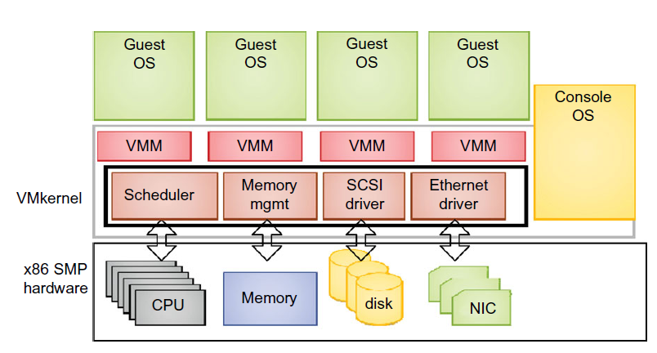
Example: VMware ESX Server for Para-Virtualization
VMware pioneered the software market for virtualization.
ESX is a VMM or a hypervisor for bare-metal x86 symmetric multiprocessing (SMP) servers. It accesses hardware resources such as I/O directly and has complete resource management control.
An ESX-enabled server consists of four components:
a virtualization layer,
a resource manager,
hardware interface components, and
a service console, as shown in Figure.
To improve performance, the ESX server employs a para-virtualization architecture in which the VM kernel interacts directly with the hardware without involving the host OS.
The VMM layer virtualizes the physical hardware resources such as CPU, memory, network and disk controllers, and human interface devices.

Slide 58
The VMware ESX server architecture using para-virtualization
The resource manager allocates CPU, memory disk, and network bandwidth and maps them to the virtual hardware resource set of each VM created.
Hardware interface components are the device drivers and the VMware ESX Server File System.
The service console is responsible for booting the system, initiating the execution of the VMM and resource manager, and relinquishing control to those layers.
It also facilitates the process for system administrators.

Slide 59
VIRTUALIZATION OF CPU, MEMORY, AND I/O DEVICES
To support virtualization, processors such as the x86 employ a special running mode and instructions, known as hardware-assisted virtualization.
In this way, the VMM and guest OS run in different modes and all sensitive instructions of the guest OS and its applications are trapped in the VMM.
To save processor states, mode switching is completed by hardware. For the x86 architecture, Intel and AMD have proprietary technologies for hardware-assisted virtualization.

Slide 60
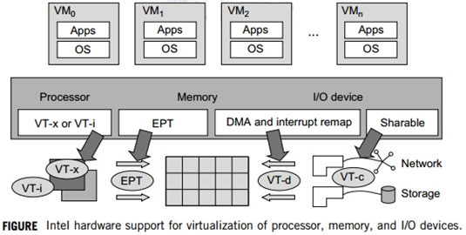
Hardware Support for Virtualization in the Intel x86 Processor
Since software-based virtualization techniques are complicated and incur performance overhead, Intel provides a hardware-assist technique to make virtualization easy and improve performance.
Figure next provides an overview of Intel’s full virtualization techniques.
For processor virtualization, Intel offers the VT-x or VT-i technique. VT-x adds a privileged mode (VMX Root Mode) and some instructions to processors. This enhancement traps all sensitive instructions in the VMM automatically.
For memory virtualization, Intel offers the EPT, which translates the virtual address to the machine’s physical addresses to improve performance.
For I/O virtualization, Intel implements VT-d and VT-c to support this.

Slide 61
Virtualization of CPU
A VM is a duplicate of an existing computer system in which a majority of the VM instructions are executed on the host processor in native mode.
Unprivileged instructions of VMs run directly on the host machine for higher efficiency. Other critical instructions should be handled carefully for correctness and stability.
The critical instructions are divided into three categories: privileged instructions, control sensitive instructions, and behavior-sensitive instructions.
Privileged instructions execute in a privileged mode and will be trapped if executed outside this mode.
Control-sensitive instructions attempt to change the configuration of resources used.
Behavior-sensitive instructions have different behaviors depending on the configuration of resources, including the load and store operations over the virtual memory.

Slide 62
Virtualization of CPU
A CPU architecture is virtualizable if it supports the ability to run the VM’s privileged and unprivileged instructions in the CPU’s user mode while the VMM runs in supervisor mode.
When the privileged instructions including control- and behavior-sensitive instructions of a VM are executed, they are trapped in the VMM.
The VMM acts as a unified mediator for hardware access from different VMs to guarantee the correctness and stability of the whole system.
However, not all CPU architectures are virtualizable.
RISC CPU architectures can be naturally virtualized because all control- and behavior-sensitive instructions are privileged instructions.
x86 CPU architectures are not primarily designed to support virtualization. This is because about 10 sensitive instructions, such as SGDT and SMSW, are not privileged instructions.
When these instructions execute in virtualization, they cannot be trapped in the VMM.

Slide 63
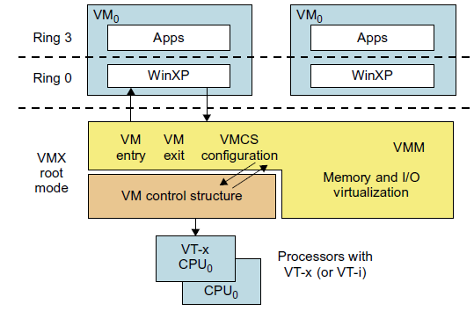
Virtualization of CPU: Hardware-Assisted CPU Virtualization
Hardware-assisted virtualization should have high efficiency. However, since the transition from the hypervisor to the guest OS incurs high overhead switches between processor modes, it sometimes cannot outperform binary translation.
Hence, virtualization systems such as VMware now use a hybrid approach, in which a few tasks are offloaded to the hardware but the rest is still done in software. In addition, para-virtualization and hardware-assisted virtualization can be combined to improve the performance further.

Slide 64
Memory Virtualization
In a traditional execution environment, the operating system maintains mappings of virtual memory to machine memory using page tables, which is a one-stage mapping from virtual memory to machine memory.
All modern x86 CPUs include a memory management unit (MMU) and a translation lookaside buffer (TLB) to optimize virtual memory performance.
In a virtual execution environment, virtual memory virtualization involves sharing the physical system memory in RAM and dynamically allocating it to the physical memory of the VMs.
That means a two-stage mapping process should be maintained by the guest OS and the VMM, respectively: virtual memory to physical memory and physical memory to machine memory.
Furthermore, MMU virtualization should be supported, which is transparent to the guest OS.
The guest OS continues to control the mapping of virtual addresses to the physical memory addresses of VMs. But the guest OS cannot directly access the actual machine memory. The VMM is responsible for mapping the guest physical memory to the actual machine memory.
Figure next shows the two-level memory mapping procedure.

Slide 65
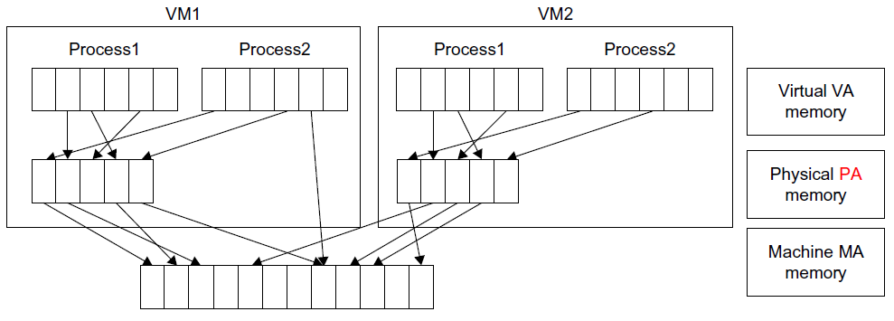
Memory Virtualization

Slide 66
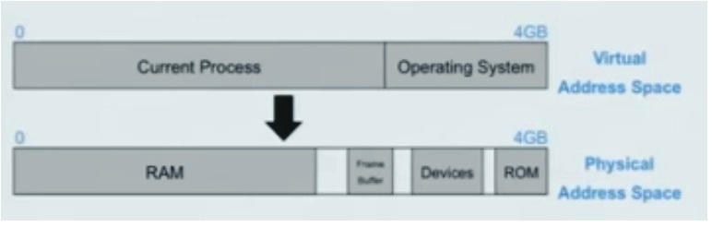
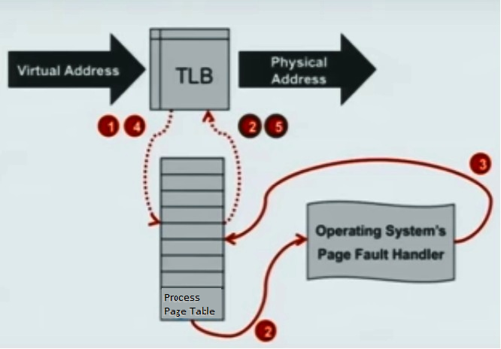
Memory Virtualization
Traditional Address Space:
Traditional Address Translation w/Architected Page Tables:

Slide 67
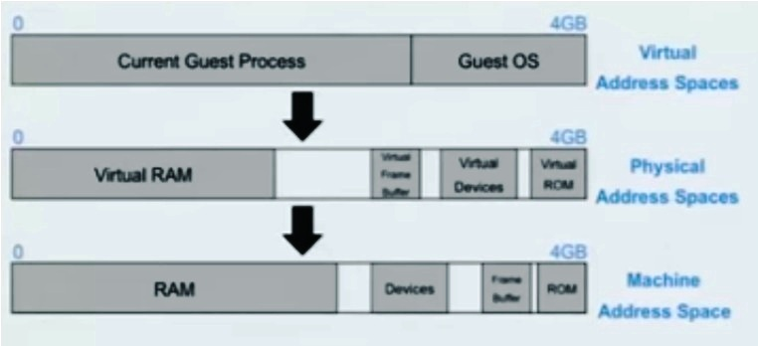
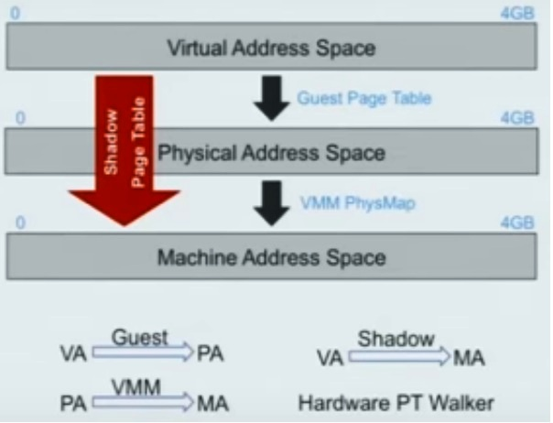
Memory Virtualization
Virtualized Address Space:
Virtualized Address Spaces W/ Shadow Page Tables:

Slide 68
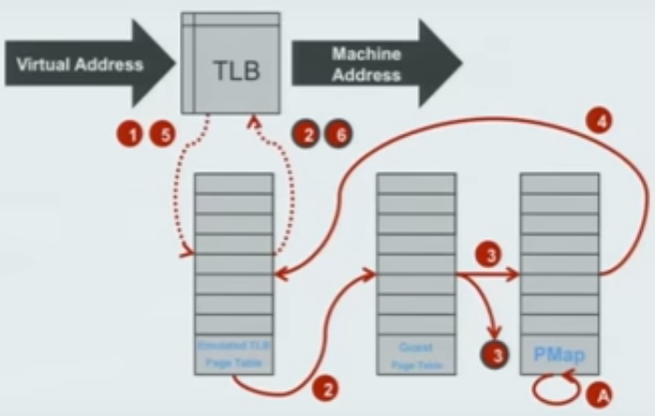
Memory Virtualization
Virtualized Address Translation w/ Shadow Page Tables:

Slide 69
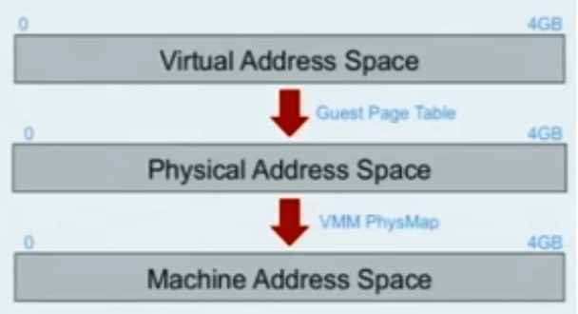
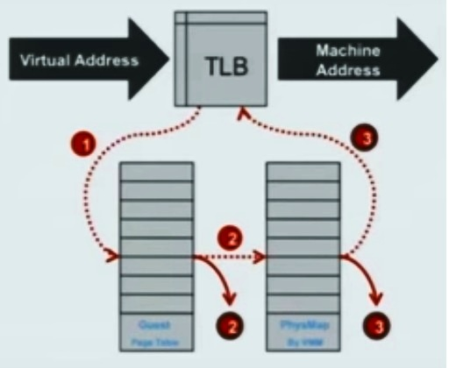
Memory Virtualization
Virtualized Address Spaces w/ Nested Page Tables:
Virtualized Address Translation w/ Nested Page Tables:

Slide 70
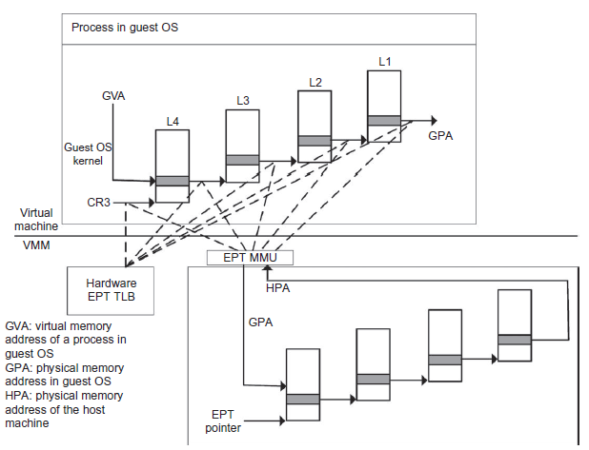
Memory Virtualization
Memory virtualization using EPT by Intel (the EPT is also known as the shadow page table).

Slide 71
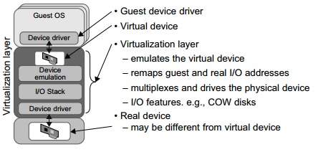
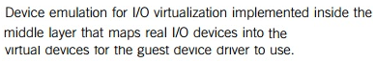
I/O Virtualization
I/O virtualization involves managing the routing of I/O requests between virtual devices and the shared physical hardware.
There are three ways to implement I/O virtualization: full device emulation, para-virtualization, and direct I/O.
Full device emulation is the first approach for I/O virtualization. Generally, this approach emulates well-known, real-world devices.
All the functions of a device or bus infrastructure, such as device enumeration, identification, interrupts, and DMA, are replicated in software.
This software is located in the VMM and acts as a virtual device.
The I/O access requests of the guest OS are trapped in the VMM which interacts with the I/O devices. The full device emulation approach is shown in Figure.

Slide 72
I/O Virtualization
Para-virtualization:
The para-virtualization method of I/O virtualization is typically used in Xen. It is also known as the split driver model consisting of a frontend driver and a backend driver.
The frontend driver is running in Domain U and the backend driver is running in Domain 0.
They interact with each other via a block of shared memory. The frontend driver manages the I/O requests of the guest OSes and the backend driver is responsible for managing the real I/O devices and multiplexing the I/O data of different VMs.
Although para-I/O-virtualization achieves better device performance than full device emulation, it comes with a higher CPU overhead.

Slide 73
I/O Virtualization
Direct I/O virtualization: It lets the VM access devices directly. It can achieve close-to-native performance without high CPU costs. Since software-based I/O virtualization requires a very high overhead of device emulation, hardware-assisted I/O virtualization is critical.
Intel VT-d supports the remapping of I/O DMA transfers and device-generated interrupts. The architecture of VT-d provides the flexibility to support multiple usage models that may run unmodified, special-purpose, or “virtualization-aware” guest OSes.
I/O virtualization via self-virtualized I/O (SV-IO):
The key idea of SV-IO is to harness the rich resources of a multicore processor. All tasks associated with virtualizing an I/O device are encapsulated in SV-IO.
It provides virtual devices and an associated access API to VMs and a management API to the VMM. SV-IO defines one virtual interface (VIF) for every kind of virtualized I/O device, such as virtual network interfaces, virtual block devices (disk), virtual camera devices, and others.
The guest OS interacts with the VIFs via VIF device drivers. Each VIF consists of two message queues. One is for outgoing messages to the devices and the other is for incoming messages from the devices.
In addition, each VIF has a unique ID for identifying it in SV-IO.

Slide 74
Virtualization in Multi-Core Processors
Virtualizing a multi-core processor is relatively more complicated than virtualizing a unicore processor.
There are mainly 2 difficulties:
Application programs must be parallelized to use all cores fully, and
software must explicitly assign tasks to the cores, which is a very complex problem.
Concerning the first challenge, new programming models, languages, and libraries are needed to make parallel programming easier.
The second challenge has spawned research involving scheduling algorithms and resource management policies.
As technology scales, a new challenge called dynamic heterogeneity is emerging to mix the fat CPU core and thin GPU cores on the same chip, which further complicates the multi-core or many-core resource management.
The dynamic heterogeneity of hardware infrastructure mainly comes from less reliable transistors and increased complexity in using the transistors.

Slide 75
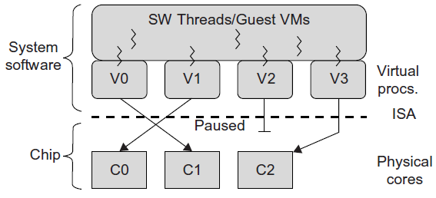
Virtualization in Multi-Core Processors
Physical versus Virtual Processor Cores: A multicore virtualization method to allow hardware designers to get an abstraction of the low-level details of the processor cores.
This technique alleviates the burden and inefficiency of managing hardware resources by software.
It is located under the ISA and remains unmodified by the operating system or VMM (hypervisor). Figure next illustrates the technique of a software-visible VCPU moving from one core to another and temporarily suspending execution of a VCPU when there are no appropriate cores on which it can run.

Slide 76
Virtualization in Multi-Core Processors
Virtual Hierarchy:
The emerging many-core chip multiprocessors (CMPs) provides a new computing landscape.
Today’s many-core CMPs use a physical hierarchy of two or more cache levels that statically determine the cache allocation and mapping. A virtual hierarchy is a cache hierarchy that can adapt to fit the workload or mix of workloads. The hierarchy’s first level locates data blocks close to the cores needing them for faster access, establishes a shared-cache domain, and establishes a point of coherence for faster communication.
When a miss occurs, it first attempts to locate the block (or sharers) within the first level. The first level can also provide isolation between independent workloads. A miss at the L1 cache can invoke the L2 access.

Slide 77
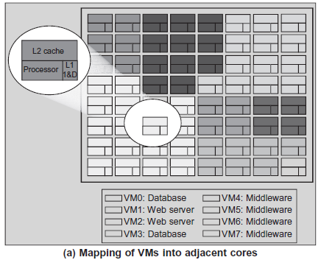
Virtualization in Multi-Core Processors: Virtual Hierarchy
Space sharing is applied to assign three workloads to three clusters of virtual cores: namely VM0 and VM3 for database workload, VM1 and VM2 for web server workload, and VM4–VM7 for middleware workload. The basic assumption is that each workload runs in its own VM.
Space sharing applies equally within a single operating system. Statically distributing the directory among tiles can do much better, provided operating systems or hypervisors carefully map virtual pages to physical frames.
A two-level virtual coherence and caching hierarchy is suggested that harmonizes with the assignment of tiles to the virtual clusters of VMs.

Slide 78
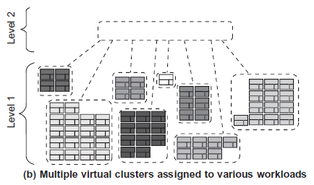
Virtualization in Multi-Core Processors: Virtual Hierarchy
Figure (b) illustrates a logical view of such a virtual cluster hierarchy in two levels. Each VM operates in a isolated fashion at the first level.
This will minimize both miss access time and performance interference with other workloads or VMs. Moreover, the shared resources of cache capacity, inter-connect links, and miss handling are mostly isolated between VMs.
The second level maintains a globally shared memory. This facilitates dynamically repartitioning resources without costly cache flushes. Maintaining globally shared memory minimizes changes to existing system software and allows virtualization features such as content-based page sharing.
Figure shows a case study focused on consolidated server workloads in a tiled architecture.
This many-core mapping scheme can also optimize for space-shared multiprogrammed workloads in a single-OS environment.

Slide 79
VIRTUAL CLUSTERS AND RESOURCE MANAGEMENT
Three critical design issues of virtual clusters:
live migration of VMs,
memory and file migrations, and
dynamic deployment of virtual clusters.
When more VMs join a network, an inefficient manual configuration always causes problems with overloading or underutilization.
Amazon’s Elastic Compute Cloud (EC2) is a good example of a web service that provides elastic computing power in a cloud. EC2 permits customers to create VMs and to manage user accounts over the time of their use.
Most virtualization platforms, including XenServer and VMware ESX Server, support a bridging mode which allows all domains to appear on the network as individual hosts.
By using this mode, VMs can communicate with one another freely through the virtual network interface card and configure the network automatically.

Slide 80
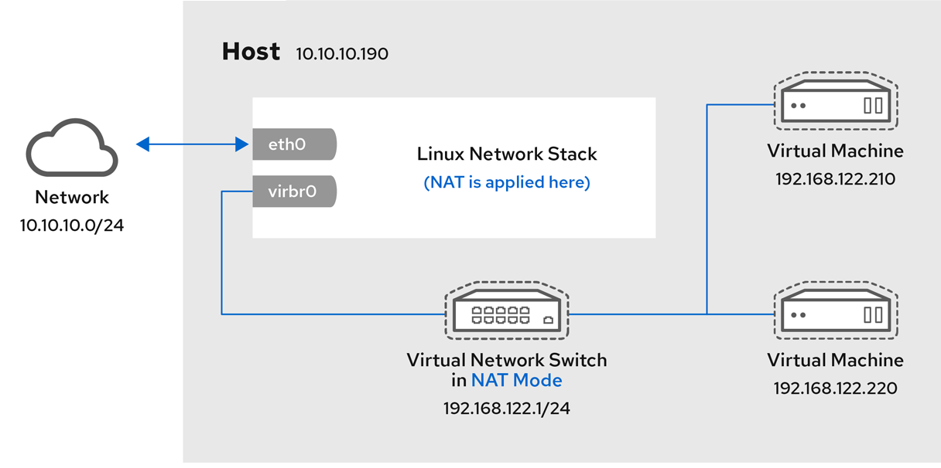
VIRTUAL CLUSTERS AND RESOURCE MANAGEMENT
When using Bridged mode, all of the guest virtual machines appear within the same subnet as the host physical machine. All other physical machines on the same physical network are aware of the virtual machines, and can access the virtual machines. Bridging operates on Layer 2 of the OSI networking model.

Slide 81
VIRTUAL CLUSTERS AND RESOURCE MANAGEMENT
Physical versus Virtual Clusters:
Virtual clusters are built with VMs installed at distributed servers from one or more physical clusters. The VMs in a virtual cluster are interconnected logically by a virtual network across several physical networks.
Figure next illustrates the concepts of virtual clusters and physical clusters. Each virtual cluster is formed with physical machines or a VM hosted by multiple physical clusters. The provisioning of VMs to a virtual cluster is done dynamically to have the following properties:
Multiple VMs running with different OSes can be deployed on the same physical node.
A VM runs with a guest OS, which is often different from the host OS, that manages the resources in the physical machine, where the VM is implemented.
The purpose of using VMs is to consolidate multiple functionalities on the same server. This will greatly enhance server utilization and application flexibility.

Slide 82
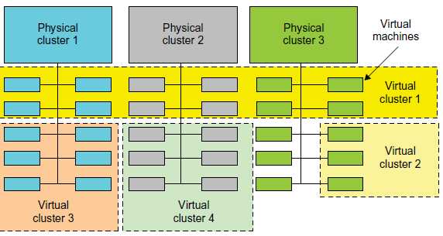
VIRTUAL CLUSTERS AND RESOURCE MANAGEMENT
Physical versus Virtual Clusters:
VMs can be replicated in multiple servers for distributed parallelism, fault tolerance, and disaster recovery.
The size (number of nodes) of a virtual cluster can grow or shrink dynamically, similar to the way an overlay network varies in size in a peer-to-peer (P2P) network.
The failure of any physical nodes may disable some VMs installed on the failing nodes. But the failure of VMs will not pull down the host system.
A cloud platform with four virtual clusters over three physical clusters shaded differently.

Slide 83
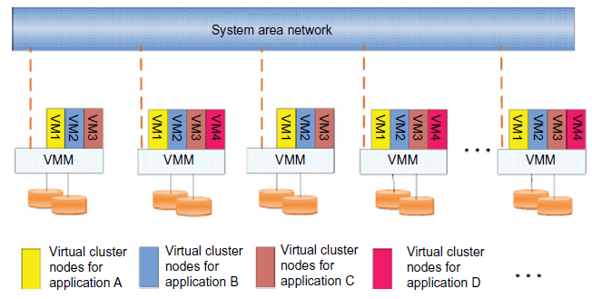
VIRTUAL CLUSTERS AND RESOURCE MANAGEMENT
Physical versus Virtual Clusters: Since system virtualization has been widely used, it is necessary to effectively manage VMs running on a mass of physical computing nodes (also called virtual clusters) and consequently build a high-performance virtualized computing environment.
This involves virtual cluster deployment, monitoring and management over large-scale clusters, as well as resource scheduling, load balancing, server consolidation, fault tolerance, and other techniques.
In a virtual cluster system, it is quite important to store the large number of VM images efficiently.
Fig: The concept of a virtual cluster based on application partitioning.

Slide 84
Physical versus Virtual Clusters:
Fast Deployment and Effective Scheduling:
The system should have the capability of fast deployment. Deployment means two things:
To construct and distribute software stacks (OS, libraries, applications) to a physical node inside clusters as fast as possible, and
To quickly switch runtime environments from one user’s virtual cluster to another user’s virtual cluster.
If one user finishes using his system, the corresponding virtual cluster should shut down or suspend quickly to save the resources to run other VMs for other users.
The live migration of VMs allows workloads of one node to transfer to another node.
The potential overhead caused by live migrations of VMs cannot be ignored.

Slide 85
Physical versus Virtual Clusters:
High-Performance Virtual Storage:
The template VM can be distributed to several physical hosts in the cluster to customize the VMs.
Existing software packages reduce the time for customization as well as switching virtual environments. It is important to efficiently manage the disk spaces occupied by template software packages.
Some storage architecture design can be applied to reduce duplicated blocks in a distributed file system of virtual clusters. Hash values are used to compare the contents of data blocks. Users have their own profiles which store the identification of the data blocks for corresponding VMs in a user-specific virtual cluster.
New blocks are created when users modify the corresponding data. Newly created blocks are identified in the users’ profiles.

Slide 86
Physical versus Virtual Clusters:
High-Performance Virtual Storage:
There are four steps to deploy a group of VMs onto a target cluster: preparing the disk image, configuring the VMs, choosing the destination nodes, and executing the VM deployment command on every host.
A template is a disk image that includes a preinstalled operating system with or without certain application software.
Templates could implement the COW (Copy on Write) format. A new COW backup file is very small and easy to create and transfer. Therefore, it definitely reduces disk space consumption.
Every VM is configured with a name, disk image, network setting, and allocated CPU and memory.
VMs with the same configurations could use pre-edited profiles to simplify the process..

Slide 87
VIRTUAL CLUSTERS AND RESOURCE MANAGEMENT
Live VM Migration Steps and Performance Effects:
When a VM fails, its role could be replaced by another VM on a different node, as long as they both run with the same guest OS.
But if its residing host node fails, a VM must stop playing its role, this problem can be mitigated with VM life migration.
Figure next shows the process of life migration of a VM from host A to host B. The migration copies the VM state file from the storage area to the host machine.

Slide 88
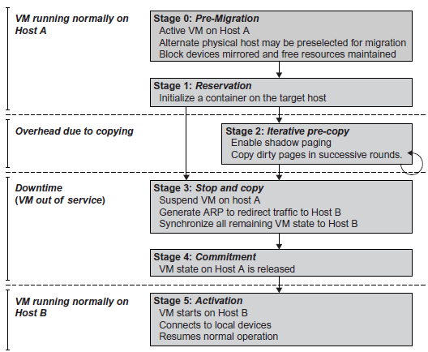
VIRTUAL CLUSTERS AND RESOURCE MANAGEMENT
Live VM Migration Steps and Performance Effects:

Slide 89
Live VM Migration Steps and Performance Effects:
As shown in Figure, live migration of a VM consists of the following six steps:
Steps 0 and 1: Start migration. This step makes preparations for the migration, including determining the migrating VM and the destination host.
In most circumstances, the migration is automatically started by strategies such as load balancing and server consolidation.
Steps 2: Transfer memory. The whole execution state of the VM is stored in memory, sending the VM’s memory to the destination node ensures continuity of the service provided by the VM.
All of the memory data is transferred in the first round, and then the migration controller recopies the memory data which is changed in the last round. These steps keep iterating until the dirty portion of the memory is small enough to handle the final copy. Precopying memory is performed iteratively, the execution of programs is not obviously interrupted.

Slide 90
Live VM Migration Steps and Performance Effects:
Step 3: Suspend the VM and copy the last portion of the data. The migrating VM’s execution is suspended when the last round’s memory data is transferred. Other non-memory data such as CPU and network states should be sent as well. The VM is stopped and its applications will no longer run. This “service unavailable” time is called the “downtime” of migration, which should be as short as possible so that it can be negligible to users.
Steps 4 and 5: Commit and activate the new host. After all the needed data is copied, on the destination host, the VM reloads the states and recovers the execution of programs in it, and the service provided by this VM continues. Then the network connection is redirected to the new VM and the dependency to the source host is cleared. The whole migration process finishes by removing the original VM from the source host.

Slide 91
Live VM Migration Steps and Performance Effects:
There are four ways to manage a virtual cluster.
1. Build Cluster Manager on a guest-based manager: The cluster manager resides on a guest system. In this, multiple VMs form a virtual cluster. For example, openMosix is an open source Linux cluster running different guest systems on top of the Xen hypervisor. Sun’s cluster Oasis, an experimental Solaris cluster of VMs supported by a VMware VMM.
2. Build a cluster manager on the host systems: The host-based manager supervises the guest systems and can restart the guest system on another physical machine. VMware HA system that can restart a guest system after failure.
3. To build and use an independent cluster manager on both the host and guest systems: This will make infrastructure management more complex.
4. To build and use an integrated cluster on the guest and host systems: This means the manager must be designed to distinguish between virtualized resources and physical resources.

Slide 92
Live VM Migration Steps and Performance Effects:
VMs can be live-migrated from one physical machine to another; in case of failure, one VM can be replaced by another VM.
Virtual clusters can be applied in computational grids, cloud platforms, and high-performance computing (HPC) systems.
Virtual clustering provides dynamic resources that can be quickly put together upon user demand or after a node failure. Virtual clustering plays a key role in cloud computing.
When a VM runs a live service, it is necessary to design a live VM migration scheme with negligible downtime, the lowest network bandwidth consumption possible, and a reasonable total migration time.
A VM can be in one of the following four states:
an inactive state is defined by the virtualization platform, under which the VM is not enabled.
an active state refers to a VM that has been instantiated at the virtualization platform to perform a real task.
a paused state corresponds to a VM that has been instantiated but disabled to process a task or paused in a waiting state.
a VM enters the suspended state if its machine file and virtual resources are stored back to the disk.

Slide 93
Live VM Migration
There are 3 types of live virtual machine migration pre-copy ,post-copy and Hybrid.
The performance of any live VM migration strategy could be measured by the following metrics:
Down Time which starts when the VM stops working during migration until it becomes available again at the destination host.
Total Migration that starts when the migration of VM memory and the CPU status start until the entire migration process is complete.
Application Degradation which refer to The degree at which the VM’s operation or application slows down due to the live migration process.
Total Transferred Bytes which refer to the total number of bytes of VM memory and the CPU status that are transferred over the network from the source host to the destination host.

Slide 94
Live VM Migration
Post-copy Approach :
In Post-copy approach, the VM is immediately paused, a minimal processor state copied, and the VM resumed at the destination, following which any memory page needed by the running applications is pulled from the source.
Pre-copy Approach:
Pre-copy migration first transfers the memory state and then the CPU state.
There are two phases in Pre-copy approach namely the Warm-up phase and Stop-and-Copy phase.
In the Warm-up phase, the hypervisor copies all the memory pages from source to destination, while the VM is still running on the source. If some memory pages are altered through the memory copy process dirty pages will be created, and it will be recopied.
In the Stop-and-Copy phase, the VM will be stopped at source, the remaining dirty pages will be copied to the destination, and VM resumed in the destination.

Slide 95
Migration of Memory, Files, and Network Resources
Memory Migration: Memory migration can be in a range of hundreds of megabytes to a few gigabytes, and it needs to be done in an efficient manner.
The Internet Suspend-Resume (ISR) technique exploits temporal locality as memory states are likely to have considerable overlap in the suspended and the resumed instances of a VM.
Temporal locality refers to the memory states differ only by the amount of work done since a VM was last suspended before being initiated for migration.
To exploit temporal locality, each file in the file system is represented as a tree of small subfiles. A copy of this tree exists in both the suspended and resumed VM instances.
The ISR technique deals with situations where the migration of live machines is not a necessity. Predictably, the downtime is high, compared to some of the other techniques.

Slide 96
Migration of Memory, Files, and Network Resources
Internet Suspend Resume Migration:
A VMM typically maps the volatile state of its VMs to files in the local file system of its host. When a VM is suspended, the corresponding files are updated to reflect volatile state at the point of suspension. If these files are copied to a remote host with similar hardware architecture, a VMM on that host can resume the VM. In other words, the VM, including the volatile state of the guest OS, has been migrated.
A distributed file system can serve as the transport mechanism for propagating suspended VM state across space and time. The obvious approach would be to place the relevant files in the shared name space of the distributed file system and configure the VMM to access that name space directly.
The VMM only accesses files in the local files system. VM files are explicitly copied into the local file system during resume operations and out of the local file system during suspend operations.

Slide 97
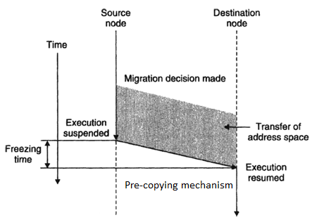
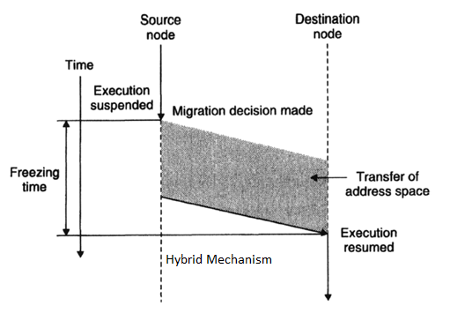
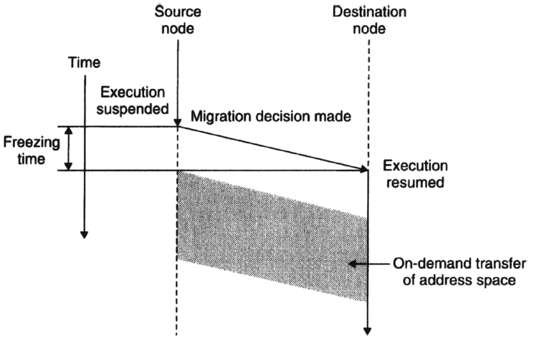
Migration of Memory, Files, and Network Resources

Slide 98
Migration of Memory, Files, and Network Resources
File System Migration:
The VMM only accesses its local file system. The relevant VM files are explicitly copied into the local file system for a resume operation and taken out of the local file system for a suspend operation. This approach relieves developers from the complexities of implementing several different file system calls for different distributed file systems.
VMM has to store the contents of each VM’s virtual disks in its local files, which have to be moved around with the other state information of that VM.
In smart copying, the VMM exploits spatial locality. It is possible to transmit only the difference between the two file systems at suspending and resuming locations.

Slide 99
Migration of Memory, Files, and Network Resources
File System Migration:
To support VM migration, a system must provide each VM with a consistent, location-independent view of the file system that is available on all hosts.
To achieve this is to provide each VM with its own virtual disk which the file system is mapped to and transport the contents of this virtual disk along with the other states of the VM.
Due to the current trend of high capacity disks, migration of the contents of an entire disk over a network is not a viable solution.
Another way is to have a global file system across all machines where a VM could be located. This way removes the need to copy files from one machine to another because all files are network accessible.
A distributed file system is used in ISR serving as a transport mechanism for propagating a suspended VM state. The actual file systems are not mapped onto the distributed file system.

Slide 100
Migration of Memory, Files, and Network Resources
Network Migration:
A migrating VM should maintain all open network connections without relying on forwarding mechanisms on the original host or on support from mobility or redirection mechanisms.
Each VM can also have its own distinct virtual MAC address along-with a distinct virtual IP address. The VMM maintains a mapping of the virtual IP and MAC addresses to their corresponding VMs.
A migrating VM includes all the protocol states and carries its IP address with it. If the source and destination machines of a VM migration are typically connected single switched LAN, the migrating host is provided advertising that the IP has moved to a new location. This solves the open network connection problem by reconfiguring all the peers to send future packets to a new location.
Although a few packets that have already been transmitted might be lost, there are no other problems with this mechanism.
On a switched network, the migrating OS can keep its original Ethernet MAC address and rely on the network switch to detect its move to a new port.

Slide 101
Migration of Memory, Files, and Network Resources
Live migration techniques mainly use the precopy approach, which first transfers all memory pages, and then only copies modified pages during the last round iteratively. The VM service downtime is expected to be minimal by using iterative copy operations.
When applications’ writable working set becomes small, the VM is suspended and only the CPU state and dirty pages in the last round are sent out to the destination.
In the precopy phase, although a VM service is still available, much performance degradation will occur because the migration daemon continually consumes network bandwidth to transfer dirty pages in each round.
An adaptive rate limiting approach is employed to mitigate this issue, but total migration time is prolonged by nearly 10 times.
The maximum number of iterations must be set because not all applications’ dirty pages are ensured to converge to a small writable working set over multiple rounds.

Slide 102
Migration of Memory, Files, and Network Resources
These issues with the precopy approach are caused by the large amount of transferred data during the whole migration process.
A check-pointing /recovery and trace/replay approach (CR/TR-Motion) is proposed to provide fast VM migration. This approach transfers the execution trace file in iterations rather than dirty pages, which is logged by a trace daemon. The total size of all log files is much less than that of dirty pages.
So, total migration time and downtime of migration are drastically reduced. However, CR/TR-Motion is valid only when the log replay rate is larger than the log growth rate.
In postcopy strategy, all memory pages are transferred only once during the whole migration process and the baseline total migration time is reduced.
But the downtime is much higher than that of precopy due to the latency of fetching pages from the source node before the VM can be resumed on the target.
With the advent of multicore or many-core machines, we can exploit CPU resources to compress page frames and the amount of transferred data can be significantly reduced.

Slide 103
Migration of Memory, Files, and Network Resources
Live Migration of VM Using Xen:
Domain 0 (or Dom0) performs tasks to create, terminate, or migrate to another host. Xen uses a send/recv model to transfer states across VMs.
Xen also supports VM migration by using a mechanism called Remote Direct Memory Access (RDMA).
Migration daemons running in the management VMs are responsible for performing migration.
Shadow page tables in the VMM layer trace modifications to the memory page in migrated VMs during the precopy phase.
Corresponding flags are set in a dirty bitmap. At the start of each precopy round, the bitmap is sent to the migration daemon. Then, the bitmap is cleared and the shadow page tables are destroyed and re-created in the next round.
The system resides in Xen’s management VM. Memory pages denoted by bitmap are extracted and compressed before they are sent to the destination. The compressed data is then decompressed on the target.

Slide 104

Migration of Memory, Files, and Network Resources
Live Migration of VM Using Xen:

Slide 105

Migration of Memory, Files, and Network Resources
Live Migration of VM Using Xen:

Slide 106
VIRTUALIZATION FOR DATA-CENTER AUTOMATION
Data centers have grown rapidly and all major IT companies like Google, Yahoo!, Amazon, Microsoft, HP, Apple, and IBM are pouring their resources into building new data centers.
Data-center automation means that huge volumes of hardware, software, and database resources in these data centers can be allocated dynamically to millions of Internet users simultaneously, with guaranteed QoS and cost-effectiveness.
This automation process is triggered by the growth of virtualization products and cloud computing services. The latest virtualization development highlights high availability (HA), backup services, workload balancing, and further increases in client bases.

Slide 107
Server Consolidation in Data Centers
In data centers, a large number of heterogeneous workloads can run on servers at various times. These heterogeneous workloads can be roughly divided into two categories: chatty workloads and noninteractive workloads.
Chatty workloads may burst at some point and return to a silent state at some other point. A web video service is an example of this, whereby a lot of people use it at night and few people use it during the day.
Noninteractive workloads do not require people’s efforts to make progress after they are submitted. High-performance computing is an example of this. At various stages, the requirements for resources of these workloads are dramatically different. However, to guarantee that a workload will always be able to cope with all demand levels, the workload is statically allocated enough resources so that peak demand is satisfied.

Slide 108

Server Consolidation in Data Centers
Figure below illustrates server virtualization in a data center. In this case, the granularity of resource optimization is focused on the CPU, memory, and network interfaces. Therefore, most servers in data centers are underutilized.
A large amount of hardware, space, power, and management cost of these servers is wasted.

Slide 109
Server Consolidation in Data Centers
Server consolidation is an approach to improve the low utility ratio of hardware resources by reducing the number of physical servers. Among several server consolidation techniques such as centralized and physical consolidation, virtualization-based server consolidation is the most powerful.
Data centers need to optimize their resource management. These techniques are performed with the granularity of a full server machine, which makes resource management far from well optimized.
Server virtualization enables smaller resource allocation than a physical machine.
The use of VMs increases resource management complexity. This causes a challenge in terms of how to improve resource utilization as well as guarantee QoS in data centers.

Slide 110
Server Consolidation in Data Centers
Server virtualization has the following effects:
1. Consolidation enhances hardware utilization. Many underutilized servers are consolidated into fewer servers to enhance resource utilization. Consolidation also facilitates backup services and disaster recovery.
2. This approach enables more easy (agile) provisioning and deployment of resources. In a virtual environment, the images of the guest OSes and their applications are readily cloned and reused.
3. The total cost of ownership is reduced : Server virtualization causes deferred purchases of new servers, a smaller data-center footprint, lower maintenance costs, and lower power, cooling, and cabling requirements.
4. This approach improves availability and business continuity. The crash of a guest OS has no effect on the host OS or any other guest OS. It becomes easier to transfer a VM from one server to another, because virtual servers are unaware of the underlying hardware.

Slide 111
Server Consolidation in Data Centers
To automate data-center operations:
resource scheduling,
architectural support,
power management,
automatic or autonomic resource management,
performance of analytical models.
In virtualized data centers, an efficient, on-demand, fine-grained scheduler is one of the key factors to improve resource utilization. Scheduling and reallocations can be done at the VM level, server level, and data-center level.
Dynamic CPU allocation is based on VM utilization and application-level QoS metrics. One method uses a two-level resource management system to handle the complexity involved. A local controller at the VM level and a global controller at the server level are designed.
They implement autonomic resource allocation via the interaction of the local and global controllers.

Slide 112
Server Consolidation in Data Centers
Multicore and virtualization are two cutting techniques that can enhance each other.
One can consider :
design a virtual hierarchy on a CMP in data centers.
the protocols that minimize the memory access time, inter-VM interferences,
facilitating VM reassignment, and supporting inter-VM sharing.
a VM-aware power budgeting scheme using multiple managers integrated to achieve better power management.
Consequently, the trade-off of power saving and data-center performance must be addressed.

Slide 113
Virtual Storage Management
“Storage virtualization” used before the emergence of “system virtualization” was largely used to describe the aggregation and repartitioning of disks for use by physical machines.
In system virtualization, virtual storage includes the storage managed by VMMs and guest OSes. The data stored in this environment can be classified into two categories: VM images and application data.
The most important aspects of system virtualization are encapsulation and isolation. Traditional operating systems and applications running on them can be encapsulated in VMs.
System virtualization allows multiple VMs to run on a physical machine and the VMs are completely isolated.
To achieve encapsulation and isolation, both the system software and the hardware platform, such as CPUs and chipsets, are rapidly updated. However, storage is lagging. The storage systems become the main bottleneck of VM deployment.

Slide 114
Virtual Storage Management
In virtualization environments, a virtualization layer is inserted between the hardware and traditional operating systems or a traditional operating system is modified to support virtualization.
Storage management of the guest OS performs as though it is operating in a real hard disk while the guest OSes cannot access the hard disk directly. On the other hand, many guest OSes contest the hard disk when many VMs are running on a single physical machine. Therefore, storage management of the underlying VMM is much more complex than that of guest OSes (traditional OSes).
The storage primitives used by VMs are not quick. Hence, operations such as remapping volumes across hosts and checkpointing disks are frequently clumsy and esoteric, and sometimes simply unavailable.

Slide 115
Virtual Storage Management
Parallax is a cluster volume manager for virtual disks: each physical host shares access to a single, globally visible block device, which is collaboratively managed to present individual virtual disk images (VDIs) to VMs.
Parallax is a distributed storage system customized for virtualization environments. Content Addressable Storage (CAS) is a solution to reduce the total size of VM images, and therefore supports a large set of VM-based systems in data centers.
It supports all popular system virtualization techniques, such as paravirtualization and full virtualization.
For each physical machine, Parallax customizes a special storage appliance VM. The storage appliance VM acts as a block virtualization layer between individual VMs and the physical storage device. It provides a virtual disk for each VM on the same physical machine.
No support for sharing of VDIs as the goal is to present virtual disks to VMs. This eliminates the requirement for a distributed lock manager, and dramatically simplifies Parallax design.

Slide 116


Virtual Storage Management

Slide 117

Cloud OS for Virtualized Data Centers

Slide 118
Trust Management in Virtualized Data Centers
The VM-based IDS contains a policy engine and a policy module. The policy framework can monitor events in different guest VMs by operating system interface library and PTrace indicates trace to secure policy of monitored host.
It’s difficult to predict and prevent all intrusions without delay. Therefore, an analysis of the intrusion action is extremely important after an intrusion occurs.
Most computer systems use logs to analyze attack actions, but it is hard to ensure the credibility and integrity of a log.
The IDS log service is based on the operating system kernel.
Thus, when an operating system is invaded by attackers, the log service should be unaffected.

Slide 119

Trust Management in Virtualized Data Centers
The architecture of livewire for intrusion detection using a dedicated VM.

Slide 120
Common Standards: The Open Cloud Consortium, Open Virtualization Format, Standards for Application Developers: Browsers (Ajax), Data (XML, JSON), Solution Stacks (LAMP and LAPP),Syndication (Atom, Atom Publishing Protocol, and RSS), Standards for Security.

Slide 121
Open Virtualization Format
The Open Virtualization Format (OVF) is a new standard that has emerged within the Virtualization Management Initiative (VMAN).
The OVF simplifies interoperability, security, and virtual machine life-cycle management by describing an open, secure, portable, efficient, and extensible format for the packaging and distribution of one or more virtual appliances.
The OVF specifies procedures and technologies to permit integrity checking of the virtual machines (VM) to ensure that they have not been modified since the package was produced. This enhances security of the format and will help to alleviate security concerns of users who adopt virtual appliances produced by third parties.
The OVF also provides mechanisms that support license checking for the enclosed VMs, addressing a key concern of both independent software vendors and customers.
The OVF allows an installed VM to acquire information about its host virtualization platform and runtime environment, which allows the VM to localize the applications it contains and optimize its performance for the particular virtualization environment.

Slide 122
Open Virtualization Format
One key feature of the OVF is virtual machine packaging portability. Since OVF is, by design, virtualization platform-neutral, it provides the benefit of enabling platform-specific enhancements to be captured.
It also supports many open virtual hard disk formats. Virtual machine properties are captured concisely using OVF metadata. OVF is optimized for secure distribution. It supports content verification and integrity checking based on industry-standard public key infrastructure and provides a basic scheme for management of software licensing.

Slide 123

Open Virtualization Format

Slide 124

Open Virtualization Format

Slide 125

Open Virtualization Format

Slide 126

Open Virtualization Format

Slide 127

Open Virtualization Format

Slide 128

Open Virtualization Format

Slide 129

Open Virtualization Format

Slide 130
Standards for Application Developers
Browser (Ajax):
Asynchronous JavaScript and XML can be defined as a set of users in building websites and web applications.
The main work of Ajax is to update the content asynchronously means in user’s web page whole content need not be reloaded and only the required field is reloaded.
XML is a markup language means these are coded languages to annotate parts of a web document which gives web browsers instructions about understanding and displaying the user content.
It combines various programming tools like JavaScript, HTML, DHTML, XML (extensible markup language), CSS (cascading style sheets), DOM (document object model) and Microsoft object.
In Ajax when the user needs to create content XHTML is used while CSS is used for presenting the user request purpose, document object model (DOM) and javascript both will be used to display the content dynamically.

Slide 131

Standards for Application Developers
How it works?

Slide 132
Standards for Application Developers
Data (XML, JSON):
Extensible Markup Language (XML) is a specification for creating custom markup languages. It is classified as an extensible language because it allows the user to define markup elements.
Its purpose is to enable sharing of structured data. XML is used to describe structured data and to serialize objects.
Various XML-based protocols exist to represent data structures for data interchange purposes.
Using XML is arguably more complex than using JSON, which represents data structures in simple text formatted specifically for data interchange in an uncompressed form.
Both XML and JSON lack mechanisms for representing large binary data types such as images.
XML provides a basic syntax that can be used to share information among different kinds of computers, applications, and different organizations without needing to be converted from one to another.

Slide 133
Standards for Application Developers
An XML document has two correctness levels, well formed and valid.
A well-formed document conforms to the XML syntax rules. A document that is not well formed is not in XML format, and a conforming parser will not process it. A valid document is well formed and additionally conforms to semantic rules which can be user-defined or exist in an XML schema.
Before the advent of generalized data description languages such as XML, software designers had to define special file formats or small languages to share data between programs. This required writing detailed specifications and special-purpose parsers and writers.

Slide 134
Standards for Application Developers
JavaScript Object Notation (JSON)
JSON is a lightweight computer data interchange format. It is a text-based, human-readable format for representing simple data structures and associative arrays (called objects).
The JSON format is often used for transmitting structured data over a network connection in a process called serialization.
Its main application is in Ajax web application programming, where it serves as an alternative to the XML format. JSON is based on a subset of the JavaScript programming language.
It is considered to be a language-independent data format. Code for parsing and generating JSON data is readily available for a large variety of programming languages.

Slide 135
Standards for Application Developers
Solution Stacks (LAMP and LAPP)
LAMP: LAMP is a popular open source solution commonly used to run dynamic web sites and servers. The acronym derives from the fact that it includes:
Linux,
Apache,
MySQL, and
PHP (or Perl or Python) and is considered by many to be the platform of choice for development and deployment of high-performance web applications which require a solid and reliable foundation.
The combination of these technologies is used primarily to define a web server infrastructure or for creating a programming environment for developing software.
Linux, Apache, PostgreSQL, and PHP(or Perl or Python)

Slide 136
Standards for Application Developers
Syndication (Atom, Atom Publishing Protocol, and RSS)
Content syndication provides citizens convenient access to new content and headlines from government via RSS (Really Simple Syndication) and other online syndication standards. Governments are providing access to more and more information online.
As web sites become more complex and difficult to sift through, new or timely content is often buried.
Dynamically presenting “what’s new” an the top of the web site is only the first step. Sharing headlines and content through syndication standards such as RSS (the little orange [XML] button, ATOM, and others) essentially allows a government to control a small window of content across web sites that choose to display the government’s headlines.
Headlines may also be aggregated and displayed through “newsreaders” by citizens through standalone applications or as part of their personal web page.

Slide 137
Standards for Application Developers
RSS:
RSS is a family of web feed formats used to publish frequently updated works—such as blog entries, news headlines, audio, and video—in a standardized format.
An RSS document includes full or summarized text, plus metadata such as publishing dates and authorship. Web feeds benefit publishers by letting them syndicate content automatically.
They benefit readers who want to subscribe to timely updates from web sites or to aggregate feeds from many sites into one place.
RSS feeds can be read using software called a reader that can be web-based, desktop-based, a mobile device, or any computerized Internet-connected device.
A standardized XML file format allows information to be published once and viewed by many different programs. The user subscribes to a feed by entering the feed’s URI into the reader or by clicking an RSS icon in a browser that initiates the subscription process.

Slide 138
Standards for Application Developers
Atom and Atom Publishing Protocol (APP)
The name Atom applies to a pair of related standards. The Atom Syndication Format is an XML language used for web feeds, while the Atom Publishing Protocol (AtomPub or APP) is a simple HTTP-based protocol for creating and updating web resources, sometimes known as web feeds. Web feeds allow software programs to check for updates published on a web site.
To provide a web feed, a site owner may use specialized software (CMS) that publishes a list (or “feed”) of recent articles or content in a standardized, machine-readable format.
The feed can then be downloaded by web sites that syndicate content from the feed, or by feed reader programs that allow Internet users to subscribe to feeds and view their content like headlines, full-text articles, excerpts, summaries, along with various metadata.

Slide 139
Standards for Application Developers
The Atom format was developed as an alternative to RSS. Atom, believed that RSS had limitations and flaws—such as lack of ongoing innovation and its necessity to remain backward compatible—and that there were advantages to a fresh design.
A program known as a feed reader or aggregator can check web pages on behalf of a user and display any updated articles that it finds.
Some web sites let people choose between RSS- or Atom-formatted web feeds; others offer only RSS or only Atom.
Browsers are moving toward integrated feed reader functions.

Slide 140
Standards for Application Developers
Web Services (REST)
REpresentational State Transfer (REST) is a style of software architecture for distributed hypermedia systems such as the World Wide Web.
REST refers to a collection of network architecture principles which outline how resources are defined and addressed. The term is often used in a loose sense to describe any simple interface which transmits domain-specific data over HTTP without an additional messaging layer such as SOAP or session tracking via HTTP cookies.
An important concept in REST is the existence of resources, each of which is referenced with a global identifier (e.g., a URI in HTTP).
To manipulate these resources, components of the network communicate via a standardized interface (e.g., HTTP) and exchange representations of these resources (actual documents conveying information). E.g., a resource which is a circle may accept and return a representation which specifies a center point and radius, formatted in SVG (Scalable Vector Graphics), but may also accept and return a representation which specifies any three distinct points along the curve as a comma-separated list.

